Slide 1
Modernize your monolith in a cloud-native fashion
Notes:
This is an initial slide. You don’t have to say anything related to the text on the screen. The first sentence introduces the audience to the subject.

Slide 2
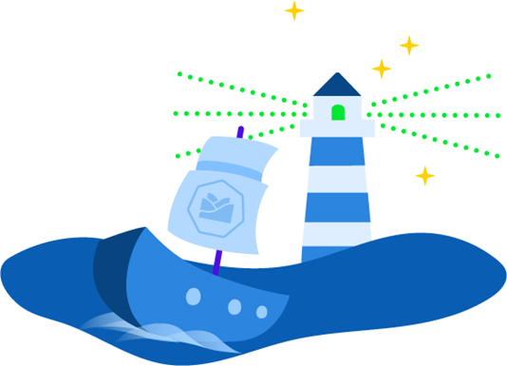
What is Kyma?
Kyma is an open-source project
designed natively on Kubernetes.
Notes:
First, make it super clear to the audience what Kyma actually is. Set clear expectations: it is for free and for Kubernetes users only. So on the one hand it is pretty limited to a specific Platform as a Service (PaaS), but on the other hand it is free.

Slide 3

What does Kyma mean?
Kyma (κύμα), pronounced as / kee-ma /, is a Greek word meaning wave.
Click the icon to hear how to pronounce Kyma
Notes:
Explain what Kyma is. Pronunciation is one thing, meaning is another. Kyma is a cozy wave on the crest of which you ride during your Kubernetes journey.

Slide 4
Challenges
Too many risks
Difficult to incorporate innovation
scenarios based on iterative
“test & learn” approach into
existing infrastructure.
Slow
Hard to develop with strong
dependency to monolith release cycles.
Too many systems
Fragmented infrastructure consisting of
various products from different vendors
that requires different skillsets to develop.
Complex access
Fast access to managed services
from cloud providers is crucial.
Service consumption is not that easy.
Monoliths get too big
Large applications are difficult
to customize or have complicated
upgrade paths.
Cloud Native is not that easy
Building applications following a
cloud-native approach requires different skillsets and knowledge about related tools.
Notes:
The purpose of this slide is to introduce Kyma to the audience through identification with challenges they might face and which they can rise to with Kyma.
When you show this slide, remember to make it clear to the audience that if there is at least one challenge they identify with, they should examine Kyma.
This slide shows each challenge one by one, but still it might be to much content for the audience. If you feel experienced enough to transform this slide into 6 separate slides, each with a headline and a picture that visualizes the headline, and then explain the content in your own words... do it.
Too many systems – there are many companies that have to integrate many products and they do it individually for each of them. Kyma makes it possible to integrate many products just in one place.
Too many risks – due to infrastructure complexity, companies tend to avoid quick, iterative innovations that can be easily introduced and then withdrawn in case of lack of success. With Kyma you can quickly prototype and introduce changes.
Slow – due to the complexity of the legacy system and its long release cycles, you can get slow with creating new functionalities. Kyma assures you are not dependent on any release cycles, you can introduce any extensions with individual release cycles.
Complex access – large organizations tend to have big teams that manage access to cloud services and are the gatekeepers of the system. It is a long run to get access to cloud providers and it is an additional process that you want to avoid. Kyma with the support of the Service Catalog can integrate services from various cloud providers.
Monoliths get too big – introducing even small changes to a monolith takes time and requires a complicated setup. Onboarding to the solution is also time consuming and complicated. With Kyma this problem doesn’t exist because it is easy to write microservices, functions or mashups of different APIs with having all the tools needed integrated.
Cloud-native is not that easy – you can start using the cloud-native approach without Kyma of course, but that it is not an easy task. You can have all the different open-source tools for monitoring, tracing, or logging, but there is not a single solution that seamlessly integrates all of them into one.

Slide 5
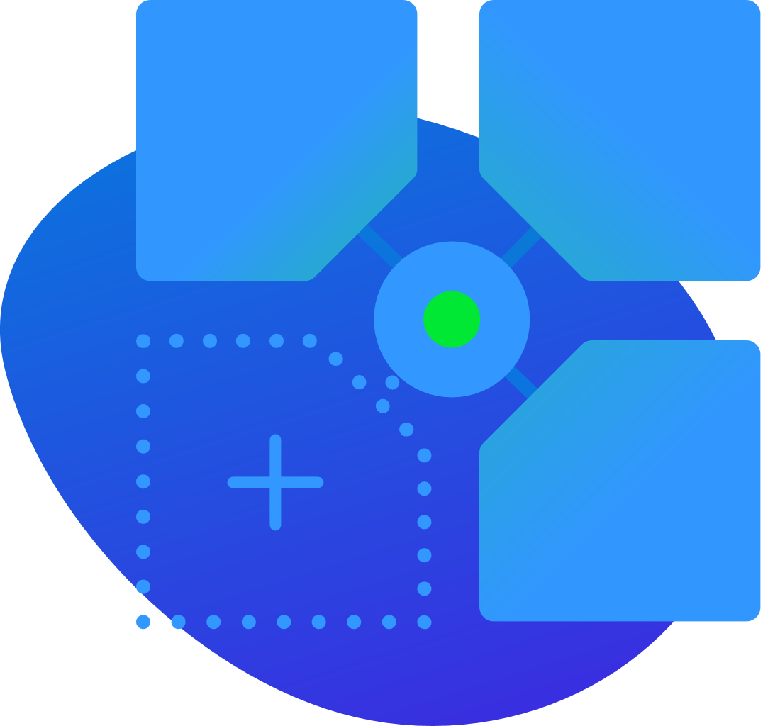
Kyma benefits
Consume services from any source, seamlessly
connect, and use the technology and
language of your choice.
Notes:
Showing this slide, refer to challenges. How does Kyma address those challenges? What are the benefits of using Kyma?

Slide 6
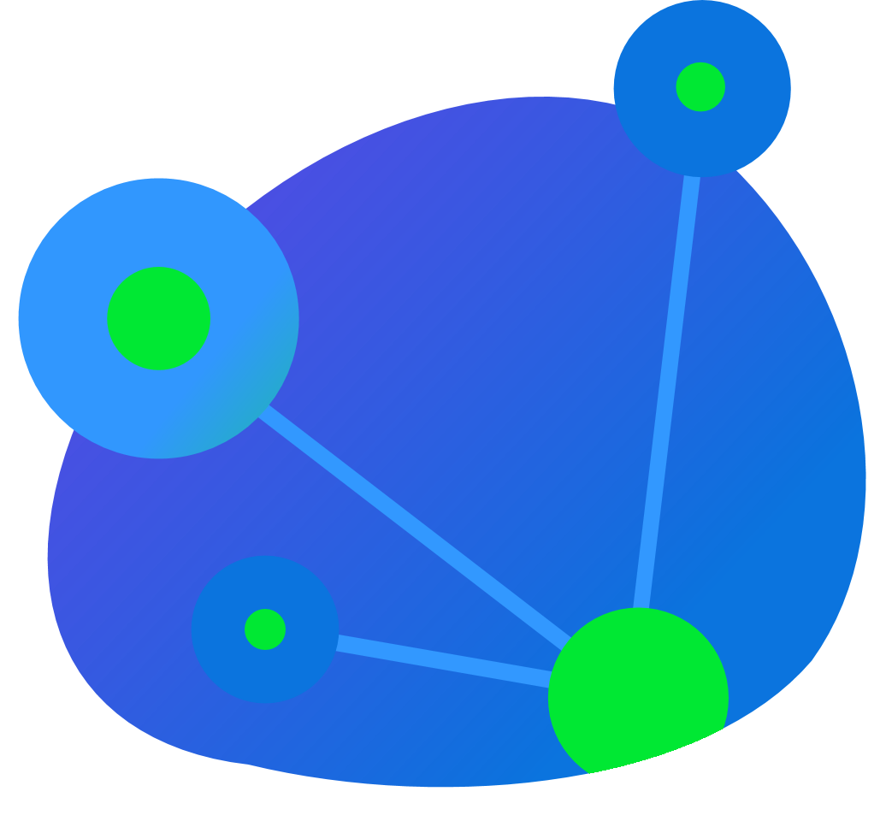
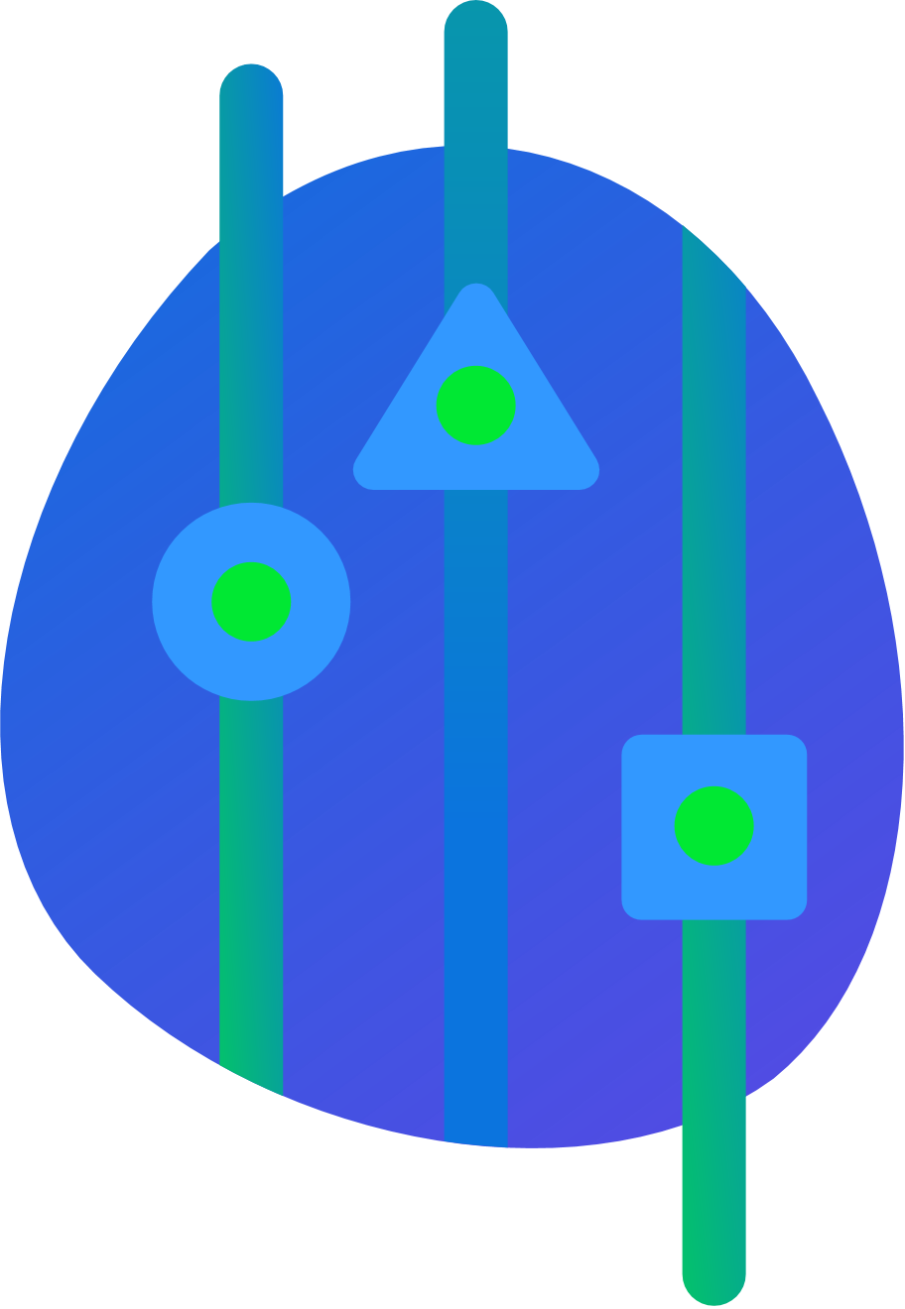
Kyma features
Serverless
Service Management
Application Connector
Notes:
This slide is closely connected to the Benefits slide. In the Benefits slide, you introduced benefits in one sentence only.
In this slide explain in more detail how to connect different services, how to connect seamlessly and that it is possible to use any technology.

Slide 7




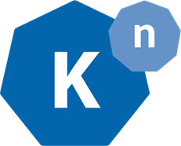

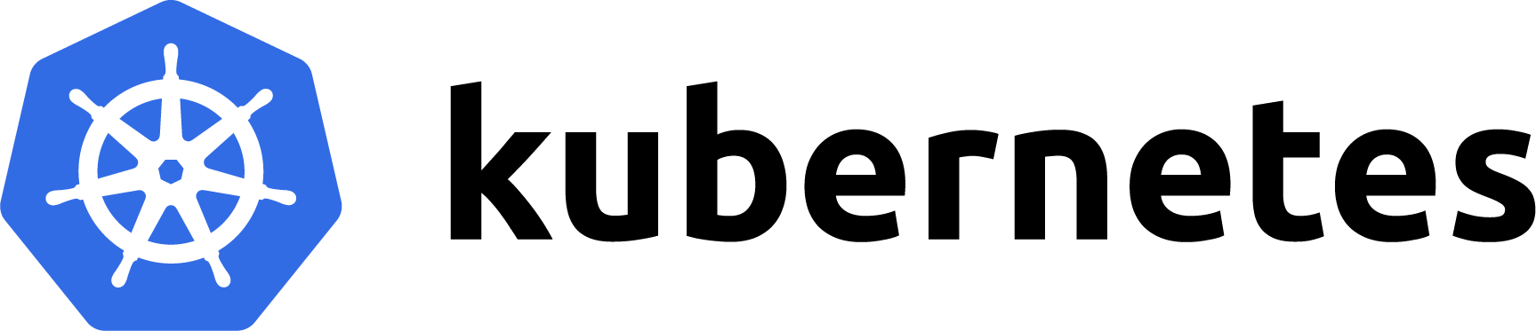



Kyma architecture
Micro API Gateway
Any Business Solution, cloud and/or on-prem
Enterprise app API calls
Observability
Any Open Service Broker (OSB) compatible service provider
Mashups
Events
Events routing
Functions
Application Connector
Service Catalog
Microservices
Kyma API calls
Service Management
Notes:
This slide relates to the slides about Kyma Benefits and Features. You already said about the benefits of using Kyma, then you described its key components, and finally you move to this slide to explain Kyma’s architecture. So you start from one sentence slogans and then you slowly, step-by-step, go into the details.
Kyma architecture is complex. This diagram is the easiest way to present it. This diagram uses icons to show all the most important projects Kyma integrates. The audience can quickly identify the icons they know and understand Kyma architecture quicker and more easily.
How to tell the story about Kyma architecture?
1. Introduce the left-hand picture as an application that can be integrated into Kyma and that exposes all functionalities inside Kyma through the Application Connector.
2. Introduce the right-hand picture to explain that in Kyma you can also consume any services, such as managed services from cloud providers.
3. Introduce the bottom picture to explain that Kyma’s vision is to run on managed k8s clusters.
4. Introduce the middle picture:
- explain that extensibility is possible thanks to events’ communication and easy consumption through microservices and functions
- explain that through the API Gateway functionality everything can be exposed to the outside
- explain that all important observability elements, such as monitoring and tracing, are embedded

Slide 8
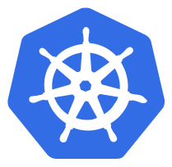




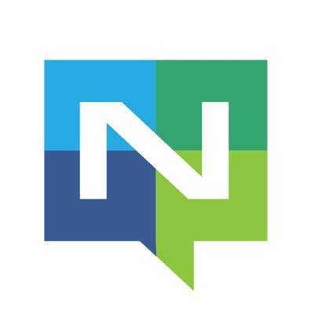
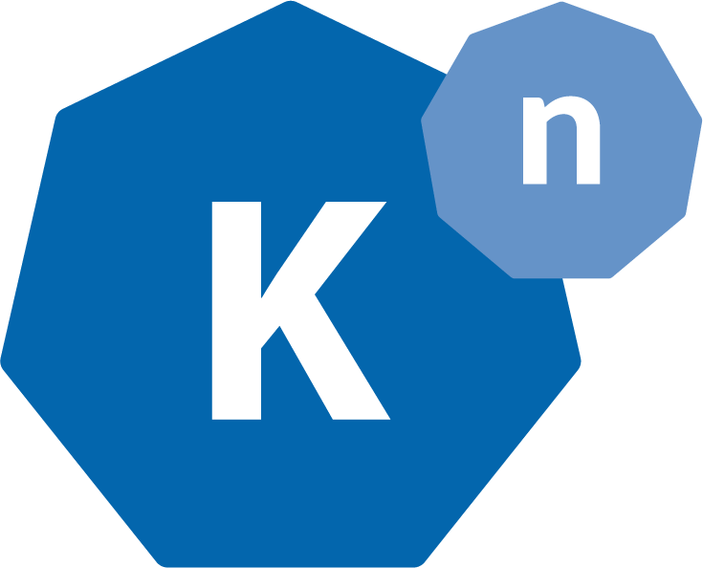

Kyma glue - cause reinventing the wheel sucks
Istio
Grafana
Jaeger
Kubernetes
OpenAPI
AsyncAPI
Loki
Prometheus
Open Service Broker
Dex
NATS
Knative
Minio
Notes:
Point out that the big advantage of Kyma is not trying to reinvent things. Kyma glues together all the best cloud-native tools and as a result you don’t have to go through the integration hell on your own.
We use Kubernetes as much as possible, for example Custom Resources or Service Catalog.
We ensure security through Dex.
We follow the best standards through integration with commonly known specifications such as the ones in the picture.
Kyma’s observability and logging stack is based on well-known and respected projects such as the ones in the picture.
Media files storage is based on Minio.
Service Mesh is realized using Istio.
And last but not least, eventing is based on Knative and NATS.
All the elements are as lightweight as possible to lower the cluster cost to the minimum.

Slide 9
There is more…
Notes:
The 3 main features mentioned before are the key feature, but there are more.

Slide 10
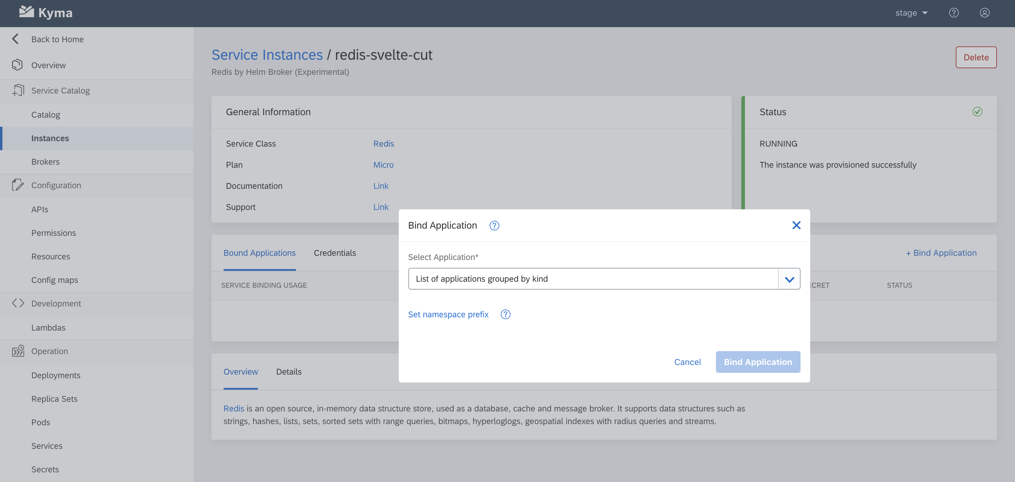
Console UI functionalities 1:1 available in CLI
Notes:
Kyma has a custom UI for both its own Kubernetes resources and other Kubernetes native resources.
The screenshot shows how to establish binding of a service into you application using the Console UI. The operation is equally easy to perform in the CLI by creating ServiceBindingUsage custom resource. Kyma’s main principles is „CLI First”.

Slide 11
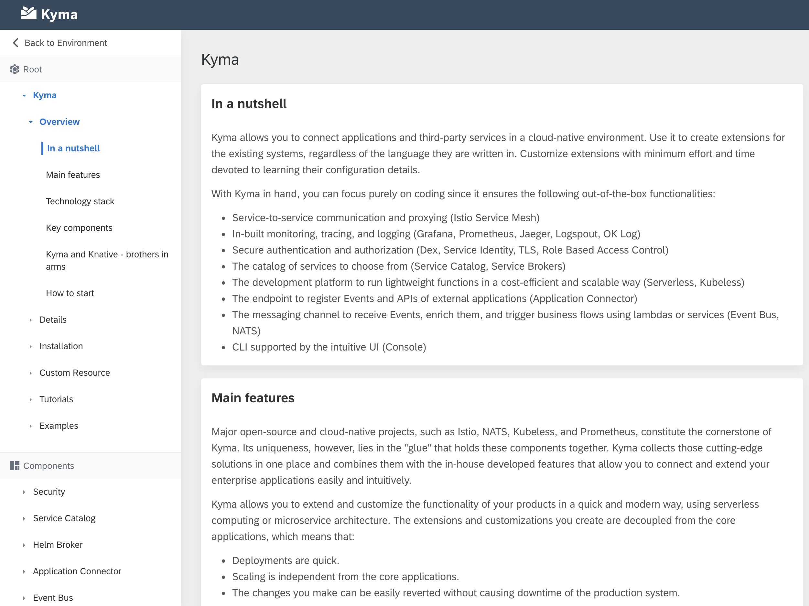
Baked-in docs
Notes:
A Kyma cluster includes documentation. The documentation is a part of the Console UI and it is always compatible with the Kyma version that was used to set up the cluster.

Slide 12
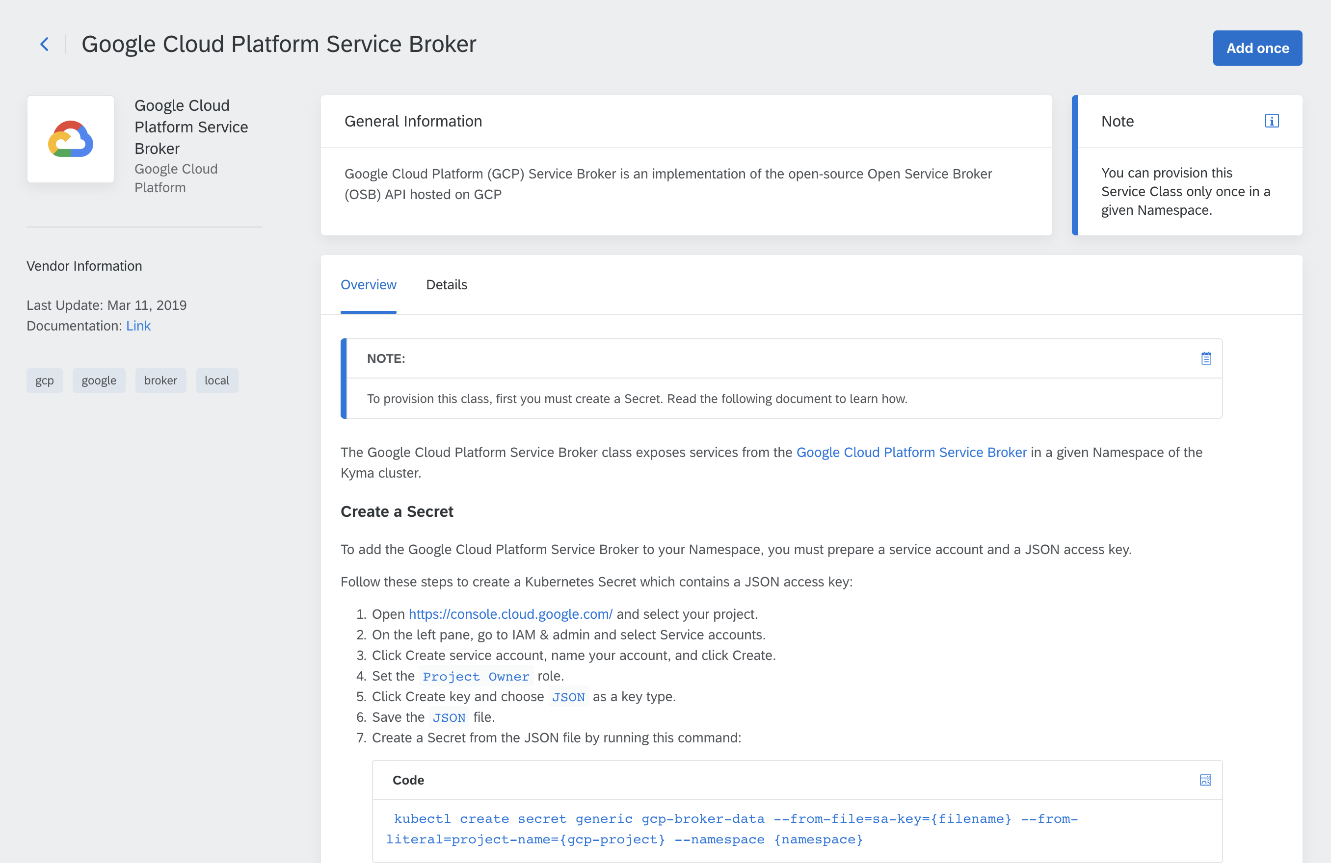
Contextual docs
Notes:
We provide contextual documentation, whenever it is possible. For example, in the Service Catalog every Service Class and its instance can be enriched with additional documentation.
And it is not only Markdown documentation. In case of APIs, if provided, we support rendering OpenAPI, OData and AsyncAPI.

Slide 13
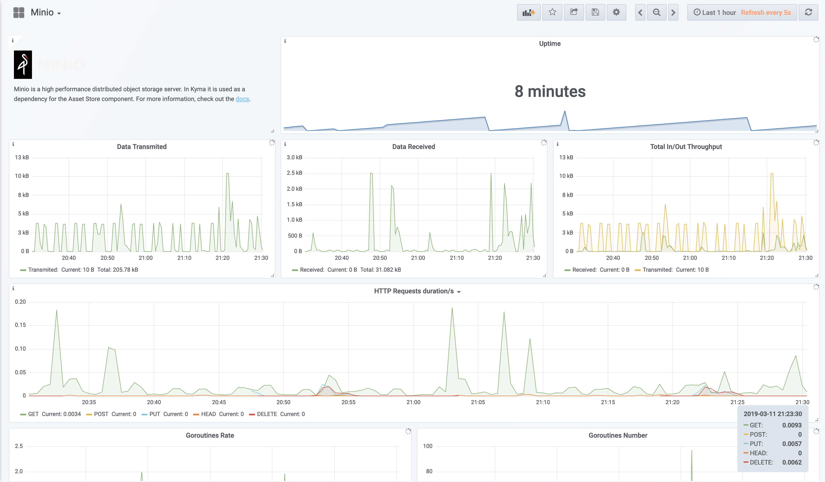
Monitoring integration
Notes:
Kyma is integrated with Prometheus and Grafana. We have a set of predefined dashboards for our components, and out-of-the-box custom dashboards for lambdas/functions.

Slide 14
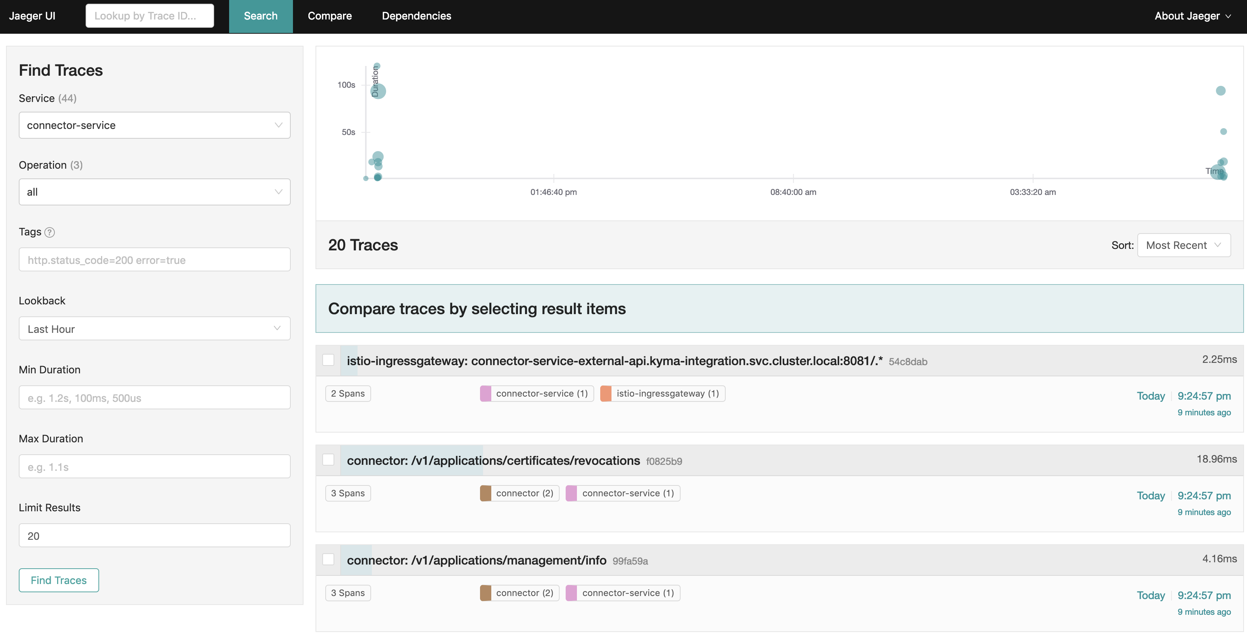
Tracing integration
Notes:
Kyma is integrated not only with Prometheus and Grafana, but also with Jaeger for tracing requests.

Slide 15
Other benefits/features
Local development with Kyma lite on Minikube
Event Bus with Knative
Micro API Gateway with Istio
UI extensibility with microfrontend approach with Luigi
Assets Store with Minio
Helm Broker for an easy exposure of helm charts in the Service Catalog
Notes:
For development, you can use Kyma lite version locally on Minikube. Kyma lite version doesn’t include the components that aren’t usually important for local development, such as monitoring and tracing. However, you can install the components locally if needed.
Internally, Kyma has a custom Event Bus based on Knative. The Event Bus handles events delivery from an external system to services and functions in Kyma.
With the support of Istio, we build a micro API Gateway. The API Gateway enables exposing services to the outside world in a convenient way.
You can add your own views to the Console UI. Luigi, which is an open-source project, makes it possible to integrate microfrontends in the UI.
We also have a component that introduces multi-cloud support for storing assets. Locally, you store files in Minio. While on a cluster you can switch to a Minio Gateway mode and use GCS or Azure Blob for storing files.
Helm Broker integrates with the Service Catalog. Using the proper configuration of different bundles repositories you can enrich Kyma Service Catalog with different services through helm charts.

Slide 16
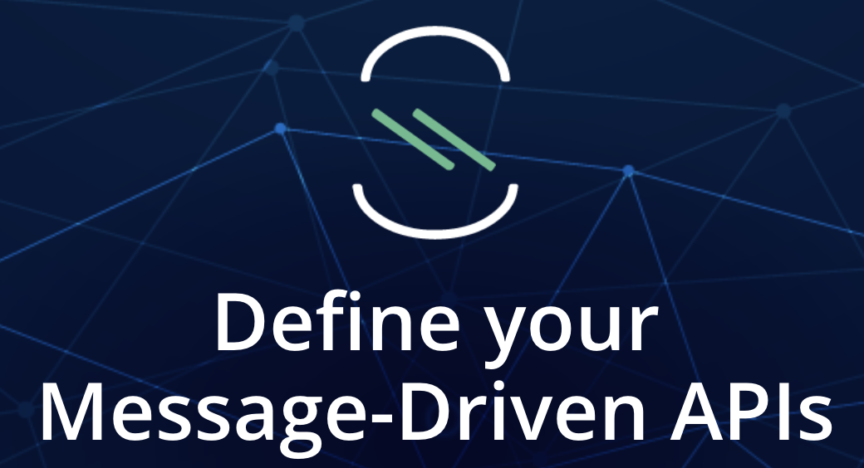
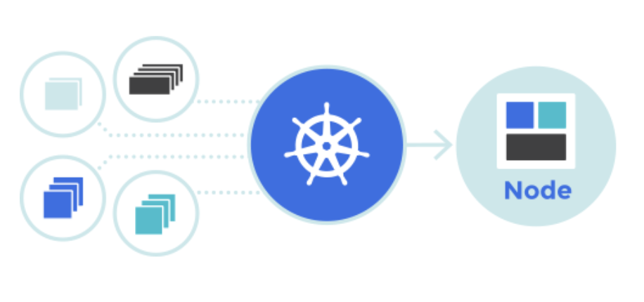
Kyma donation initiatives
Knative joint development
AsyncAPI involvement
Service Catalog SIG members
Notes:
Kyma is not only a consumer of the open source. If possible, Kyma also contributes to peer-communities. Point out the communities and advertise them.
- We donated to Knative eventing through the NATS channel.
- We donated to the AsyncAPI organization and created a spec rendering component written in react which will soon become the official spec editor.
- We contribute constantly to Kubernetes Service Catalog. For example, a significant contribution was to rewrite the solution to support custom resource definitions.

Slide 17

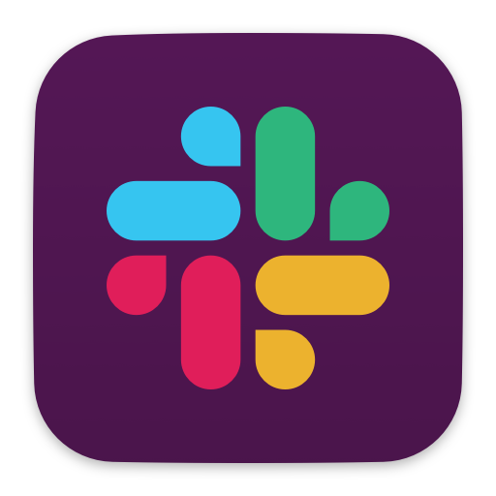
Become a Contributor
Request a feature or report a bug - https://github.com/kyma-project/kyma/
Join the SIG CORE - https://github.com/kyma-project/community/tree/master/sig-and-wg/sig-core
Contact the Kyma team directly on Slack - slack.kyma-project.io​
Notes:
Make is clear that we are open for contribution:
- It is not only code contribution that is welcome. At the beginning you can create issues and feature requests.
- We run online, public meetings so it is easy to get in touch with other contributors and experts.
- We also have a public Slack workspace where people can exchange ideas, ask questions, receive hints and tips, and gain more experience in Kyma.

Slide 18

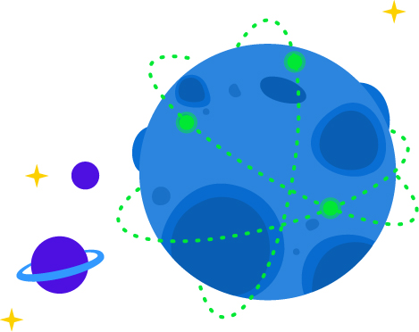


Learn more on https://kyma-project.io
@kymaproject
linkedin.kyma-project.io
youtube.kyma-project.io
YouTube
slack.kyma-project.io
github.com/kyma-project
Notes:
It is a summary of all the channels through which the community can engage in Kyma.

Slide 19
Thank you
Contact information:
Name Title Address Phone number
Notes:
Put your details here

